Slide 1
Alaska Department of Transportation & Public Facilities
Alaska Marine Highway System Comment to the Hydrographic Services Review Panel
Dana Jensen
[5/23/12]

Slide 2
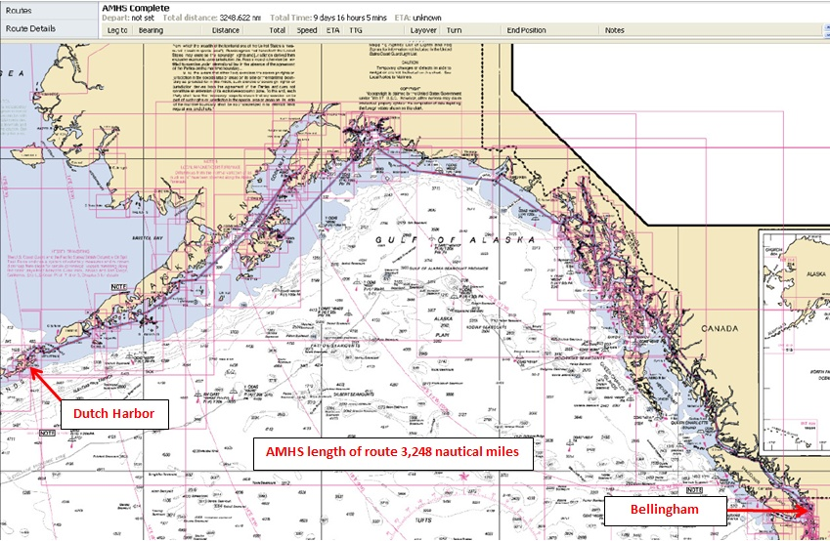

Slide 3
Fleet Profile
MV Matanuska 408 feet Built 1963
MV Malaspina 408 feet Built 1963
MV Taku 352 feet Built 1963
MV Tustumena 296 feet Built 1964
MV LeConte 235 feet Built 1974
MV Columbia 418 feet Built 1974
MV Aurora 235 feet Built 1977
MV Kennicott 382 feet Built 1998
FVF Fairweather 235 feet Built 2004
MV Lituya 181 feet Built 2004
FVF Chenega 235 feet Built 2005

Slide 4
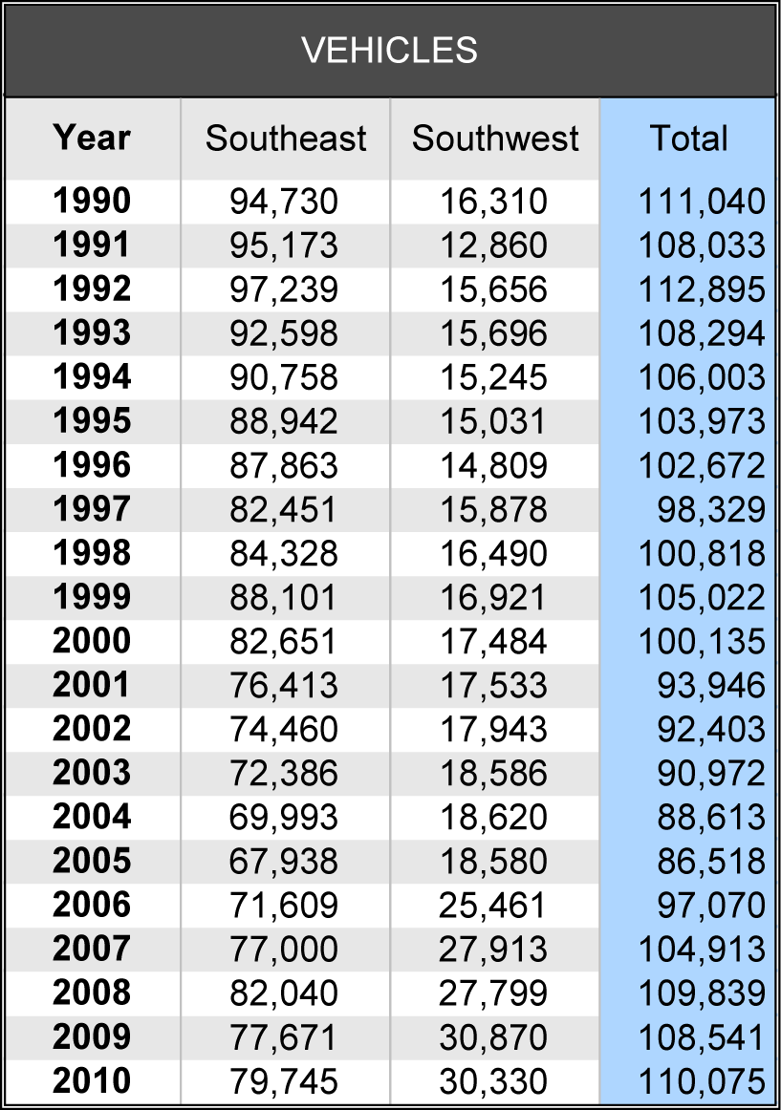
Passenger and Vehicle Traffic

Slide 5
Traffic Trends

Slide 6
Suggestions:
Overall, AMHS is very pleased with the Hydrographic Services support that we receive from NOAA. There are a few areas we believe may bare some attention:

Slide 7
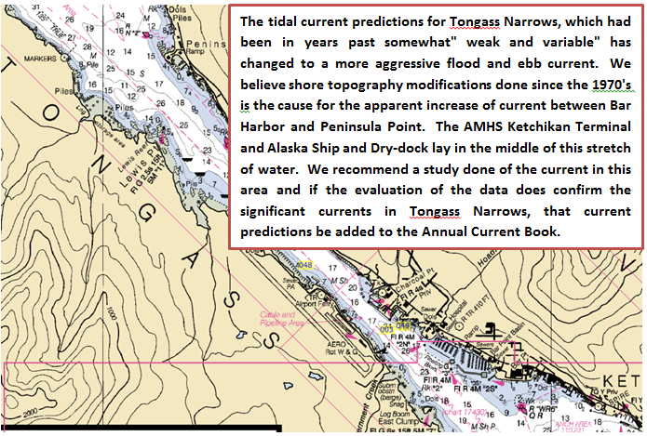

Slide 8
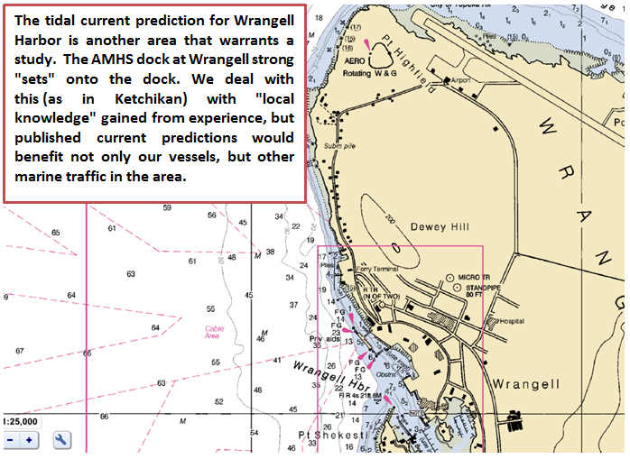

Slide 9
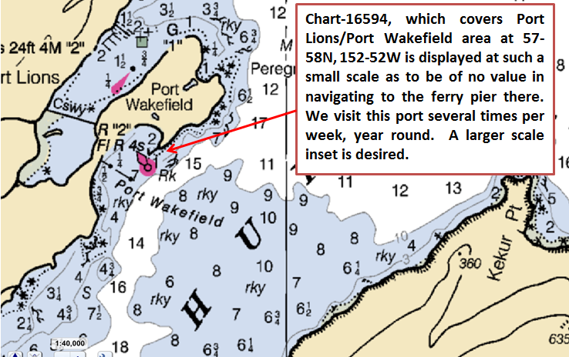

Slide 10
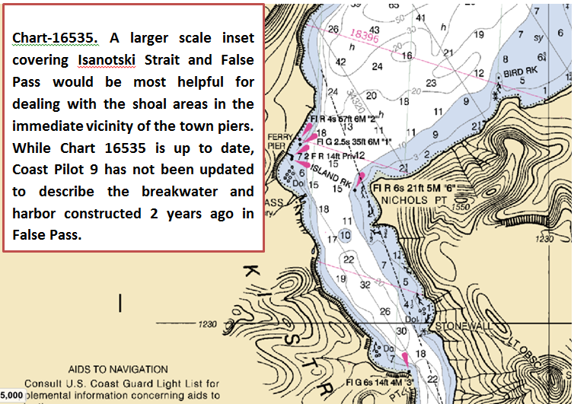

Slide 11
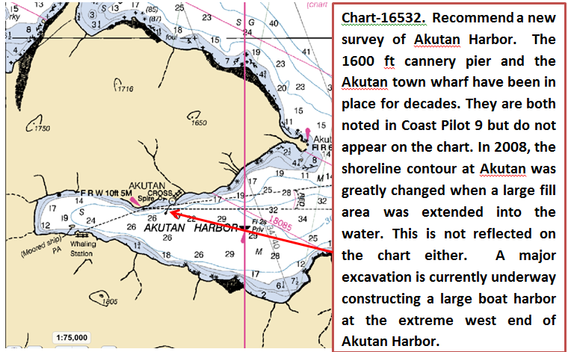

Slide 12
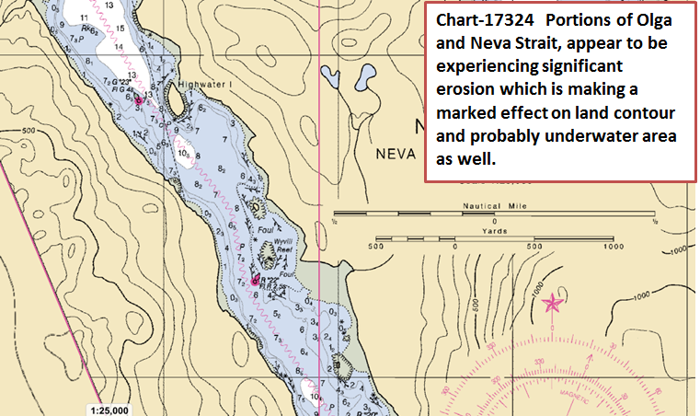

Slide 13
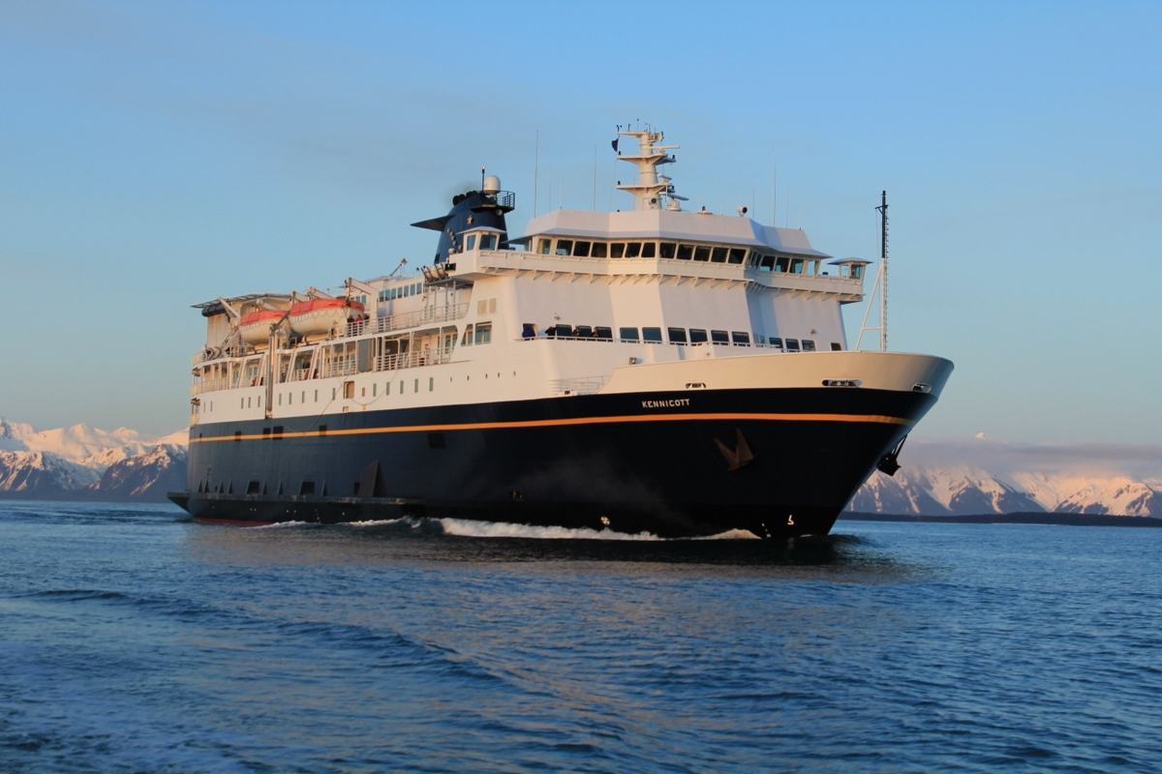
Questions?

